Slide 1




Stepping into next year at Wickham Common
A family workshop at Wickham Common
Monday 15th June 2026
Paul Cabb
Social Eyes- A Vision for Inclusion

Slide 2




Baby Child Teenager
The amazing journey of growing up is unique and at a very individual pace…

Slide 3

How was this year for you and your family?
What skills did your child learn/develop?
How have they grown and changed?
Consider the last school year
Consider the next school year as the next step of a continuing journey…

Slide 4

Looking ahead to a new school year can be…
Exciting…
A fresh start
A rite of passage
Greater independence
Learning new things
Making new friends/interests

Slide 5

However, it can also feel…
Scary and unknown
Heighten your worries
Change…when it was going well
Will my child be ready, or will it overwhelm?
Increasing learning gulf
Fearing social struggles

Slide 6

https://youtu.be/eFGECPidiUE
Rose learns about school transition - animated transition story for EYFS and KS1

Slide 7
Is the start of the new school year challenging for your child?
What are the challenges for your child?

Slide 8

For ASC children:
What does change mean…

Slide 9
Why are transitions difficult for children with Autism?
Children with autism have a hard time transitioning from one thing to another because they prefer routine and predictability
Anything that takes them out of their routine can feel overwhelming
It’s the same thing for children with sensory processing challenges. The world often feels overwhelming to them in general, so having to handle something new can be even harder

Slide 10

For ADHD:
What does change mean…

Slide 11
Why are transitions difficult for children with ADHD?
Children with ADHD have a hard time switching their attention from one thing to another. It makes sense then that they may become upset during transitions
This is especially true if they need to stop doing something that is particularly rewarding for them, since their brains react strongly to rewards

Slide 12

What can you do to support the step into next year?

Slide 13

Celebrate their achievements…
With their learning
With their practical and social skills
With their communication
With…growing into themselves
Let them know that they are ready for next year

Slide 14

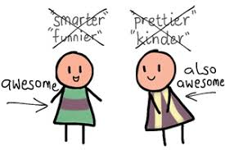
Avoid comparing your children…
It’s a journey of to get there…

Slide 15

How can we all help this transition?
See it as a rite of passage
See it as exciting – your child growing up!!
This means:
Going through all of the skills and successes your child has achieved
Looking at what makes your child unique and special
Continuing to build independence – are you doing too much?
Problem solving with your child…
Prepare for change: what will be the same/what will be different
Keep early autumn routines as similar as possible
Expect greater tiredness
Plan in some treats for the autumn

Slide 16

Look at personal goals for your child…
Celebrate with your child, let them know they have had a great year – go through their achievements no matter what they are
Be excited with your child about all of their new experiences next year and that they are ready - focus more on new experiences rather than change!!
Show them what they can do for themselves – dressing, helping, asking for help and accepting it
Introduce them to new social situations and prepare them – talk through social rules – what/why
Find new/continued ways to be around other children
Keep reading/sharing books and using number each and every day – keep it fun, through play, through cooking and through everyday life!!!!!!!!
Find contexts for reading, writing, number – show your child they can do all of these and need them every day
Solve problems together through talking and showing
Show them that your love for them is unconditional and that making mistakes and trying again is how we truly learn and grow!!!
Learning is here, there and everywhere…

Slide 17

Advice to families before the summer break
Decide if you need to contact the school about concerns – avoid building up your own anxiety over the break and this may support the staff in planning ahead for next year
This is especially if attendance has been a concern – what support can be arranged prior to the new term/outside agencies involved over the break?
If unsure, check on changes for next year/inform the school if your own family circumstance will change ie/change of address etc. over the break, diagnostic assessment due etc.
In the last few weeks of term reflect with your child if there are any concerns and how to communicate these before the break so that they feel ready for next year
Ask staff if there are any specific ways of supporting their learning over the break – this may be an outcome from end of year reports/levels
Exchange phone numbers with peers – discuss any social contact over the break before the break
As parents stay in touch with each other – mutual support!!

Slide 18
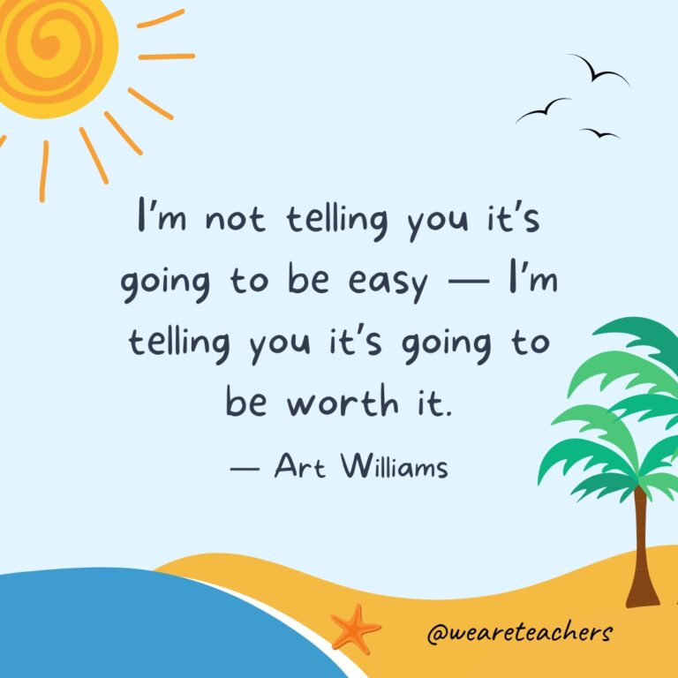
How can Wickham Common help your child transition?
All pupils will benefit from preparation for the new school year
The school will identify specific pupils who may find greater challenge – especially ASC/ADHD and children who need trauma informed support
Supporting successful transition requires:
contact with families
visits and time with the new staff/classrooms and changes
involving the child and their questions and ideas
Social Story use to support home as well as school
be aware of family circumstance (including over the break) and plan ahead ie/ family support
consider if there are adaptations to routines and new situations such as a different playground

Slide 19
What can Wickham Common do to support your child into next year?

Slide 20

Q. What if there have been changes at home?
A. Let the school know and work together
Families go through changes as well. These changes in circumstance can affect your child and come out through their behaviour, moods, confidence and play. Staff can support children by:
sharing stories about transition or loss appropriate for the child’s age
observing children to identify behaviour changes, areas of interest and friendships
For EYFS – Yr2: Having puppets and dolls in the role play area for children to use to express themselves
helping children to express their emotions through painting as well as the Zones of Regulation
talking about emotions during circle time.
Some transitions can affect the whole family, and parents may also need support. The school can help you access outside help.

Slide 21
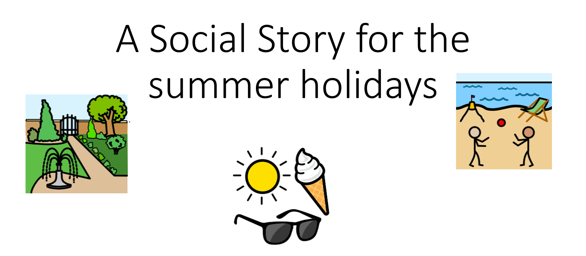
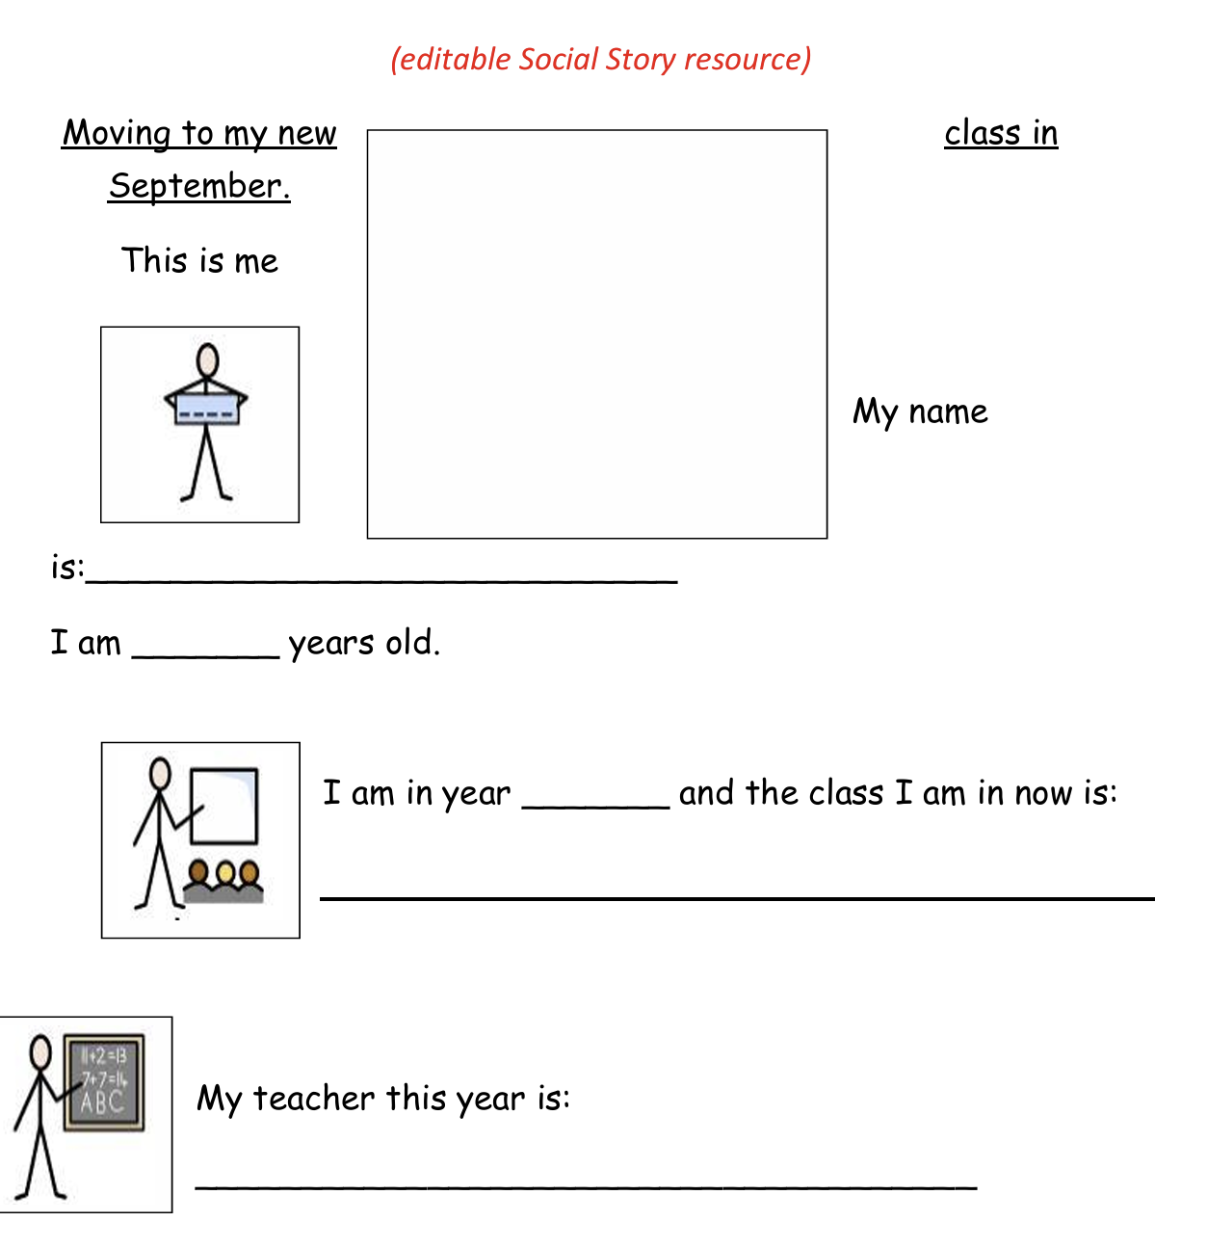
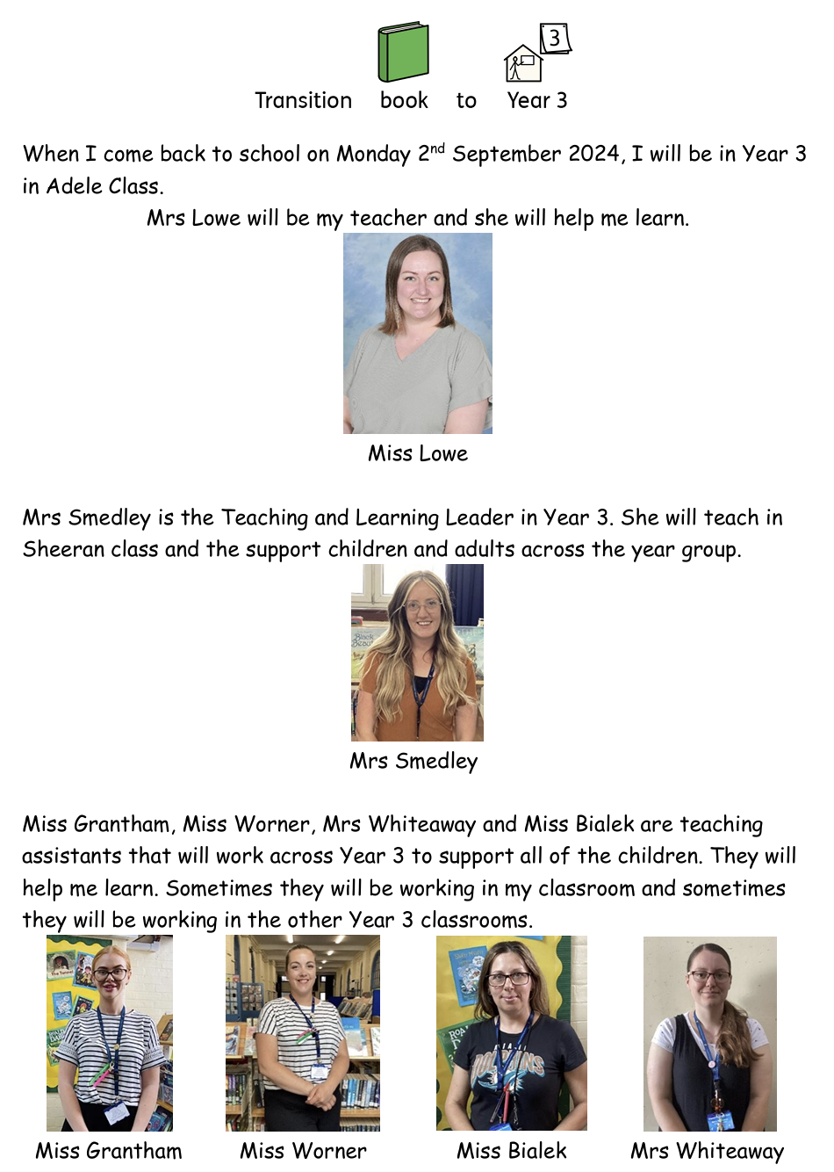

Slide 22

Let’s summarise!
Let school know about any changes in family circumstance
Engage with the school – attend meetings and parent evenings
Ensure your child attends all medical appointments and general check ups – many health factors: eyesight, hearing etc. impact on learning
Show your child that education matters – celebrate every success
Share books, learning and play with your child
Support their confidence in always having a go
Reinforce the ‘Power of Yet’
Support and encourage your children to talk
Back the school to other families and contribute to its success

Slide 23
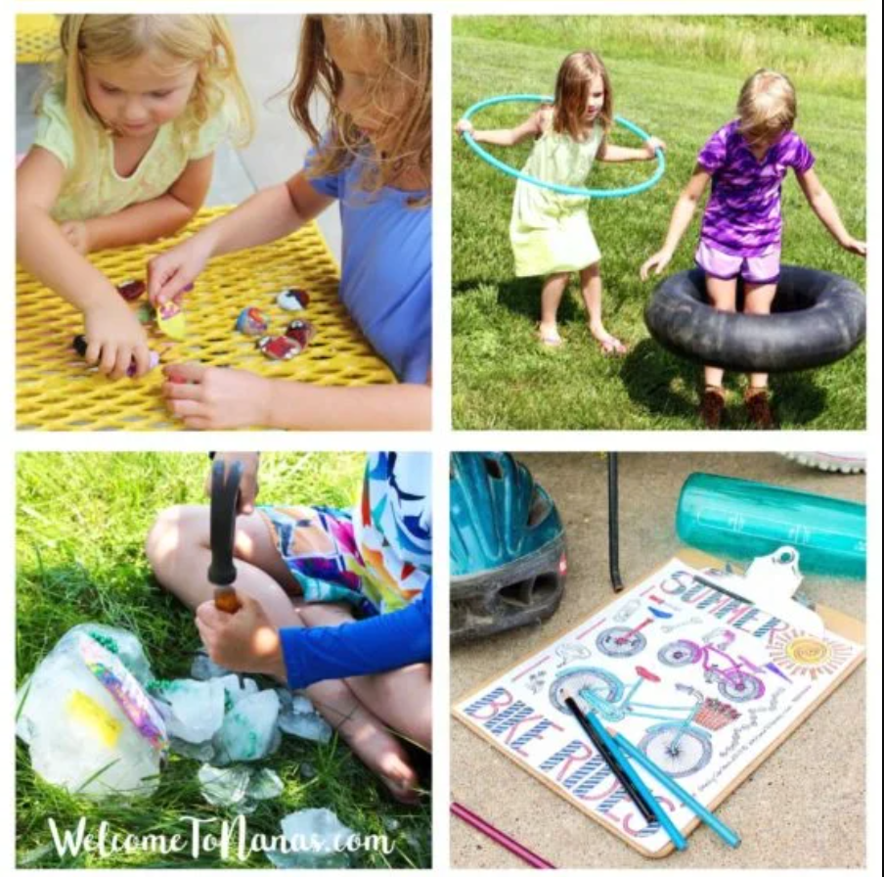

How can you support learning skills over the summer?
Keep reading habits going
Explore the natural world around us and when on holiday
Stimulate creativity and curiosity
Play board games and catch moments for number in everyday situations and games
Look for ways of building Executive Functioning Skills
Make learning social

Slide 24
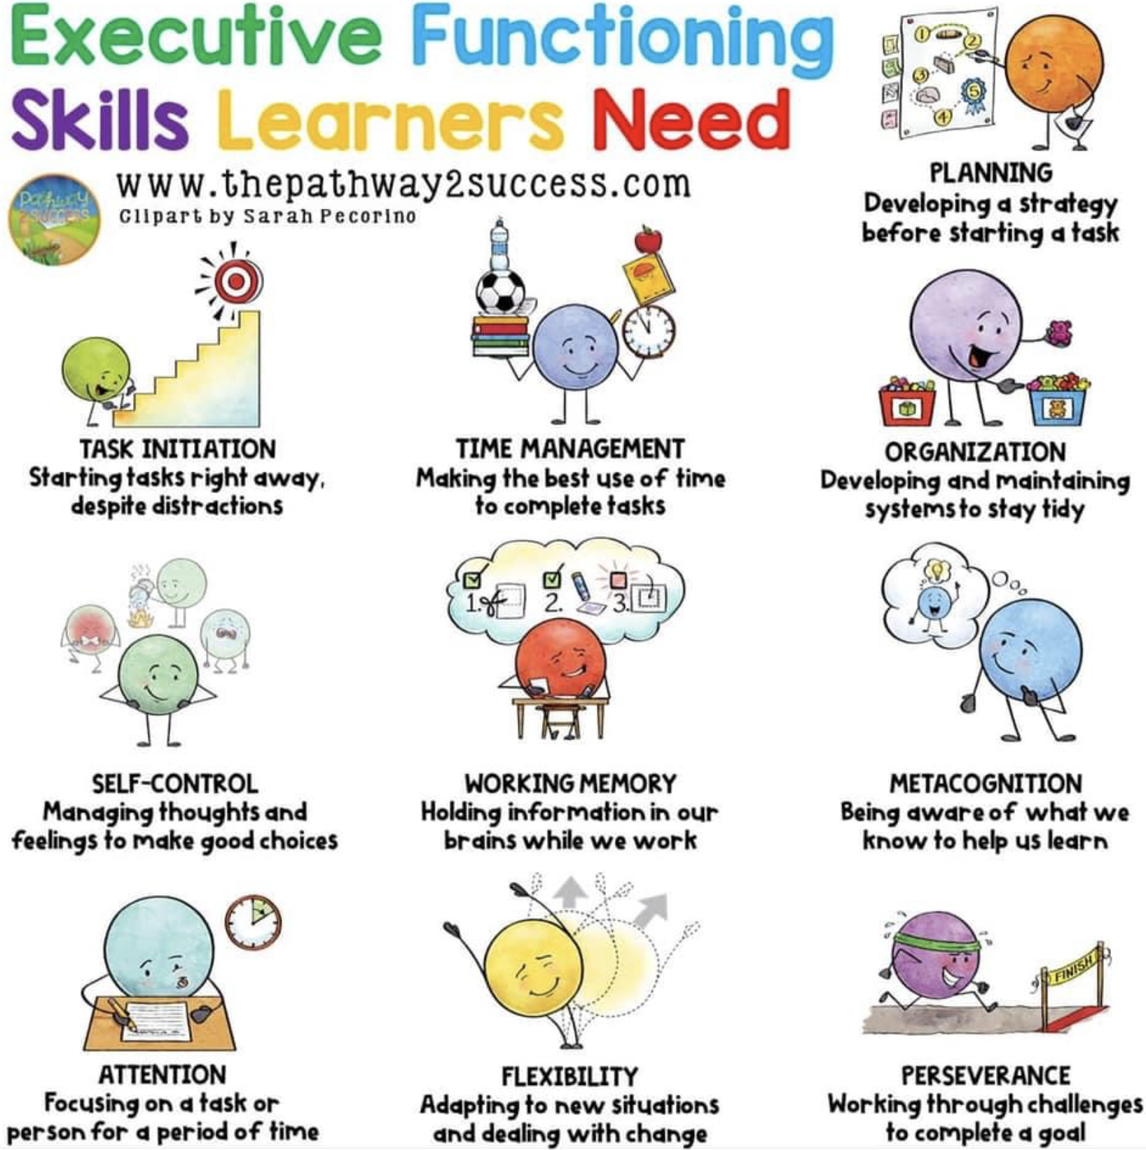
Skills to keep practicing over the break

Slide 25



Ideas for the summer…
https://readingagency.org.uk/

Slide 26
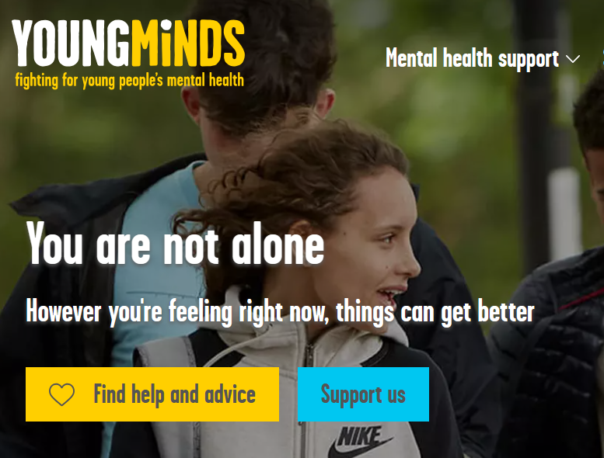

Links to advice and support…
www.autism.or.uk
www.acamh.org.uk/learning
www.minded.org.uk
www.headstogether.org.uk
www.kidscape.org.uk
Thank you for listening, have a wonderful summer!!
Paul Cabb, Social Eyes

Slide 27

Thank you for joining us and best wishes for the new school year

