Slide 1

Parent meeting:
Special Educational Needs (SEN)
Mrs Anderson Whiley Mrs Maher
(SENCO) (Strategic lead for SEND and Inclusion for Mosaic Schools Learning Trust)

Slide 2
Meeting outline
What is SEN/ national picture
SEN at Wickham Common
EHCP v SEN support
Local offer /support services
Questions

Slide 3
SEN and the National Picture
Across the country SEN numbers in schools are increasing. This may be due to a range of factors including; better and earlier identification of need, the impact of COVID-19 and a cultural shift in the acceptance and support for those with SEN.
140% increase in EHCP since 2015
£3.4 bn gap between forecast and higher needs band
50% children wait more than 20 weeks for EHCP
National Audit Office – Support for Children and Young People with SEN October 2024

Slide 4
ASC and Speech and Language are the main areas of need recorded.
Social, emotional and mental health is increasing in need.
Specialist school places are harder to obtain.
Due to a new government SEN initiatives are at the forefront however we are unsure how this will look.
The budget October 2024 allocated an extra £1bn towards SEN spending but it is unclear whether this will clear LA deficit or go into schools budget directly.

Slide 5
In January 2024 data showed that there are over 1.6 million children (18.4%) who are identified as having SEND within schools. Although COVID 19 may be a factor numbers were increasing before national lockdowns in 2020. Since 2016 EHCPs awarded have risen by 83.4% and SEN support has increased by 24.9%. EHCP in mainstream education both primary and secondary has increased from 52.7% to 54.4%.
Special Educational Needs in England 2023/24 DfE

Slide 6
What is SEN?
SEND Code of Practice 2015
This Code of Practice is statutory guidance for the following organisations:
local authorities (education, social care and relevant housing and employment and other services)
the governing bodies of schools, including non-maintained special schools
the proprietors of academies (including free schools, university technical colleges and studio schools)
the National Health Service Commissioning Board
clinical commissioning groups (CCGs)
NHS Trusts
NHS Foundation Trusts
Local Health Boards

Slide 7




Wickham Common Vision
Social, Emotional, and Academic Growth- Focus on the whole child
Inclusion & Nurturing- Ensuring all pupils feel valued.
Identifying and meeting the unique needs of our pupils.
Collaboration of families and community

Slide 8
How do we identify and support pupils with SEND?
We know when pupils need help if:
Concerns are raised by parents/carers
Teachers (referrals to SENCO via form)
Nursery/ pre schools/ pupil’s previous school
Limited progress is being made (however this does not always indicate an SEN need)
There is a change in the pupil’s behaviour/progress/presentation
A pupil asks for help
What should I do if I think my child may have special educational needs?
The class teacher is the first point of contact to discuss your child’s needs. In addition, if you have concerns then you may also wish to speak to the Special Educational Needs Coordinator (SENCO) Mrs Anderson Whiley.

Slide 9

SEN Support -
Reasonable adjustments
Reasonable adjustment (funds and resources that we have available).
This illustration to the right shows reasonable adjustments that can be made to help support pupils with SEND.
For example an adapted desk for wheelchair users.

Slide 10
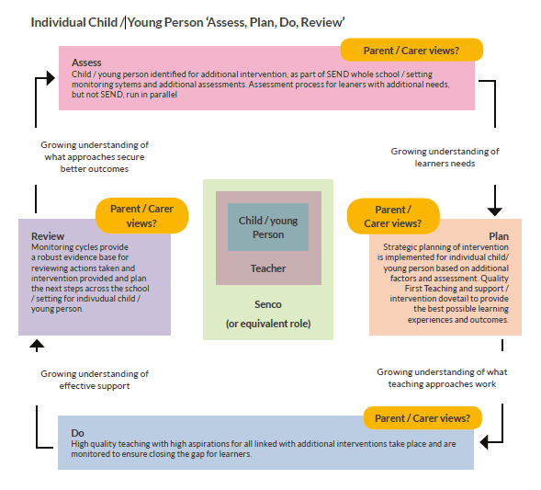
Underpinning all our provision in school is the Graduated approach
SEN t valley school
Local offer /support services
EHCP v SEN support
Questions

Slide 11

Assess
This involves clearly analysing the pupil’s needs using the class teacher’s assessment and experience of working with the pupil, details of previous progress and attainment, comparisons with peers and national data, as well as the views and experience of parents.
The pupil’s views and where relevant, advice from external support services will also be considered. Any parental concerns will be noted and compared with the school’s information and assessment data on how the pupil is progressing.
This analysis will require regular review to ensure that support and intervention is matched to need, that barriers to learning are clearly identified and being overcome and that the interventions being used are developing and evolving as required.
Where external support staff are already involved their work will help inform the assessment of need. Where they are not involved they may be contacted, if this is felt to be appropriate, following discussion and agreement from parents.

Slide 12
Plan
Planning will involve consultation between the teacher, SENCO and parents to agree the adjustments, interventions and support that are required; the impact on progress, development and or behaviour that is expected and a clear date for review.
All those working with the pupil, including support staff will be informed of their individual needs, the support that is being provided, any particular teaching strategies/approaches that are being employed and the outcomes that are being sought. This will be recorded on the class provision map or SEN support plan.

Slide 13

Do
The class teacher remains responsible for working with the child on a day-to-day basis. They will retain responsibility even where the interventions may involve group or teaching assistant support.
They will work closely with teaching assistants and /or relevant specialist staff to plan and assess the impact of support and interventions and links with classroom teaching.
Support with further assessment of the pupil’s strengths and difficulties, problem solving and advising of the implementation of effective support will be provided by the SENCO.

Slide 14
Review
Reviews will be undertaken in line with agreed dates (usually the end of each term). The review process will evaluate the impact and quality of the support and interventions.
It will also take account of the views of the pupil and their parents. The class teacher, in conjunction with the SENCO will revise the support and outcomes based on the pupil’s progress and development making any necessary amendments going forward, in consultation with parents and the pupil.
Parents will be provided with clear information about the impact of support to enable them to be involved in planning the next steps. Parents evening gives you the opportunity to gain more information.

Slide 15
Involving external agencies
We may consider that we need to seek advice and support from specialists external to the school, if progress is still not as expected.
Specialists can be involved at any point, and parents will always be involved in any decision to involve specialists.
Specialists may include:
Paediatrician ( referral criteria- what if my child does not meet this? Teach to need not label)
School nurse
Educational psychologists
Speech and language therapists
Specialist teachers e.g. for dyslexia, hearing impairment, physical disability etc
Occupational therapists
Support from the local authority –SENDAT (support with complex needs)

Slide 16


Example of the range of interventions available to our pupils
Lexia (reading and spelling)
Speech and language groups
Social skills
Fine motor skills
Targeted mathematics
Targeted phonics
Sensory circuits will be starting soon
ELSA
Counselling
Play therapy
Secondary transition interventions
Bromley Mentoring Initiative
Alongside many other in class interventions.
Run for a set amount of time (example 6 weeks) Sometimes waiting lists (ensure quality, children get the best out of this)

Slide 17
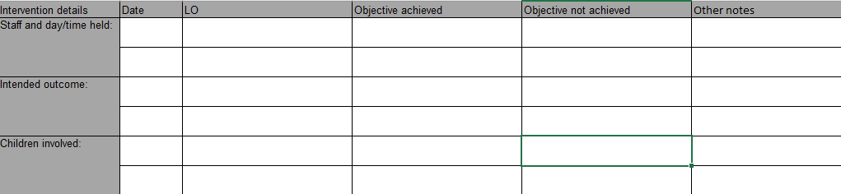
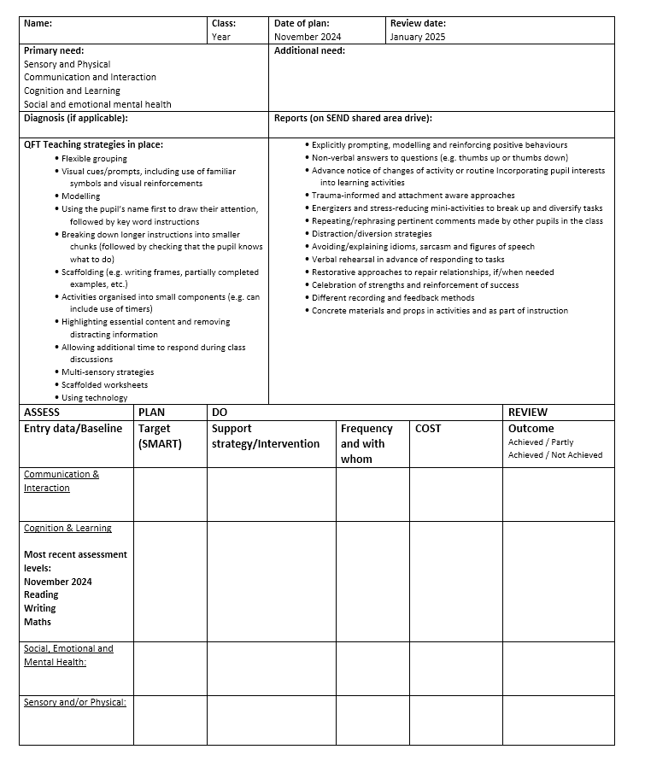
How is this recorded?
Class provision maps/Individual provision plans
CLASS PROVISION MAP
(Lower level of provision)
INDIVIDUAL PROVISION PLAN
(Children with a higher level of support)
If unsure please ask the class teacher or email the office.

Slide 18
Educational health care plans
It may be that, after following the advice and guidance from within school and from specialists, a child may need a greater level of support.
It may then be considered that an application for an Education, Health and Care Needs Assessment is made.
It is usually expected that there would be 3 cycles of assess, plan, do, review before making an application for an Education, Health and Care Needs Assessment.
The local authority will ask to see evidence of the action taken by the school as part of SEN Support. If an EHCP Needs Assessment is carried out, it may result in an Education, Health and Care Plan being issued. An EHCP is usually required to access a special school placement.
EHCPs are awarded for children requiring a significant amount of support. There is a strict criteria that needs to be met!

Slide 19

Bromley local offer!
The Bromley SEND Local Offer helps children and young people with special educational needs and/or disabilities and their families to find the information and support they are looking for from across Bromley.
Bromley Local Offer representatives are visiting school on Tuesday 8th July 9am. This will include advice on Autism and ADHD pathways.

Slide 20

Questions

